Slide 1
Database System Concepts and Architecture

Slide 2
Database System Concepts and Architecture
Development of technology reflects on the type of DBMS available
Mainframe technology-lead to single chunk of DBMS
Client server technology-resulted in small chunks called the client module which can run on a PC. It has to do with user interface, GUI etc. Example of client server technology in PEC
Server module has to do with storage, access, search and such functions

Slide 3
Data Model
Data model facilitates data abstraction
Done by a collection of concepts that are used to give the structure of the database
Describes data types, relationships and constraints
Most data models have a set of basic operations for specifying retrievals and updates

Slide 4
Data Model
Data models characterized by the types of concepts used
High level or Conceptual data model-concepts that are close to the ways users perceive data
Low level or physical data model-concepts with the way data is stored
Between the above two is representational or implementation data models which have concepts
May be understood by user but are not too far from storage details
Hides some details of the storage but can be implemented

Slide 5
Data Model
Conceptual data models use concepts such as entity, attribute and relationship.
Entity –real world object or concept, Employee
Attribute -property of an entity, Employee name
Relationship -relationship among object, eg. Employee and Project-employee works for project

Slide 6
Representational or Implementation Data Models
Models that are most frequently used in traditional commercial DBMS
Include relational model and so called legacy data models -network and hierarchical data models
Data models represent data by using record structures and are hence called record-based data models. Ex-student record

Slide 7
Object Data Models
A new family of higher-level implementation data models that are close to conceptual data models

Slide 8
Physical Data Model
Describes how data is stored by representing information such as record formats, record orderings and access paths
An access path is a structure that makes search for particular database records efficient

Slide 9
Types of Data Models
Hierarchical
Network
Relational
Entity relationship
Object oriented

Slide 10
Evolution of Major Data Models

Slide 11
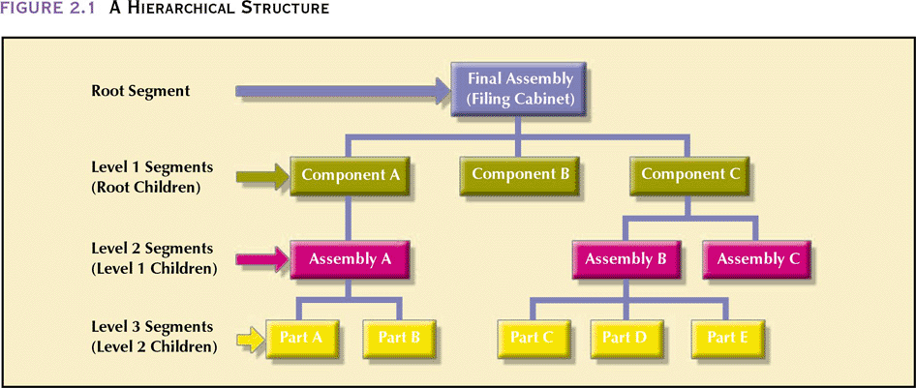

Slide 12
The Network Model
Created to
Represent complex data relationships more effectively
Improve database performance
Impose a database standard
Conference on Data Systems Languages (CODASYL)
American National Standards Institute (ANSI)
Database Task Group (DBTG)

Slide 13
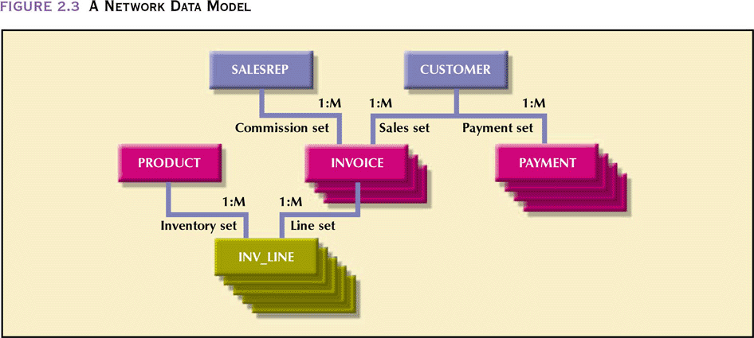

Slide 14
The Network Data Model
Advantages
Conceptual simplicity
Handles more relationship types
Data access flexibility – no need for a preorder traversal
Promotes database integrity – must first define the owner and then the member record
Data independence
Conformance to standards

Slide 15
The Network Data Model (continued)
Disadvantages
System complexity
Lack of structural independence

Slide 16
The Relational Model
Developed by Codd (IBM) in 1970
Considered ingenious but impractical in 1970
Conceptually simple
Computers lacked power to implement the relational model
Today, microcomputers can run sophisticated relational database software

Slide 17
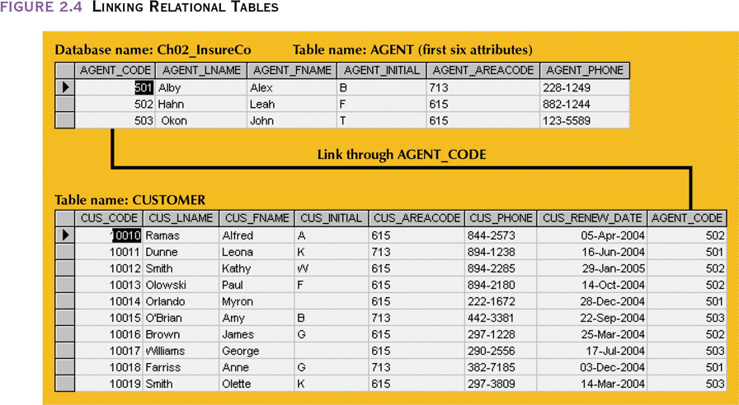
Linking Relational Tables

Slide 18
The Relational Model
Advantages
Structural independence – changes in the relational data structure do not affect the DBMS’s data access in any way
Improved conceptual simplicity by concentrating on the logical view
Easier database design, implementation, management, and use
Ad hoc query capability - SQL
Powerful database management system

Slide 19
The Relational Model (continued)
Disadvantages
Substantial hardware and system software overhead
Can facilitate poor design and implementation
May promote “islands of information” problems

Slide 20
The Entity Relationship Model
Widely accepted and adapted graphical tool for data modeling
Introduced by Peter Chen in 1976
Graphical representation of entities and their relationships in a database structure

Slide 21
The Entity Relationship Model
Advantages
Exceptional conceptual simplicity
Visual representation
Effective communication tool
Integrated with the relational data model

Slide 22
The Entity Relationship Model
Disadvantages
Limited constraint representation
Limited relationship representation
No data manipulation language
Loss of information content

Slide 23
Object Oriented Data Model— Basic Structure
Object: abstraction of a real-world entity
Attributes describe the properties of an object
Objects that share similar characteristics are grouped in classes
Classes are organized in a class hierarchy
Inheritance is the ability of an object within the class hierarchy to inherit the attributes and methods of classes above it

Slide 24
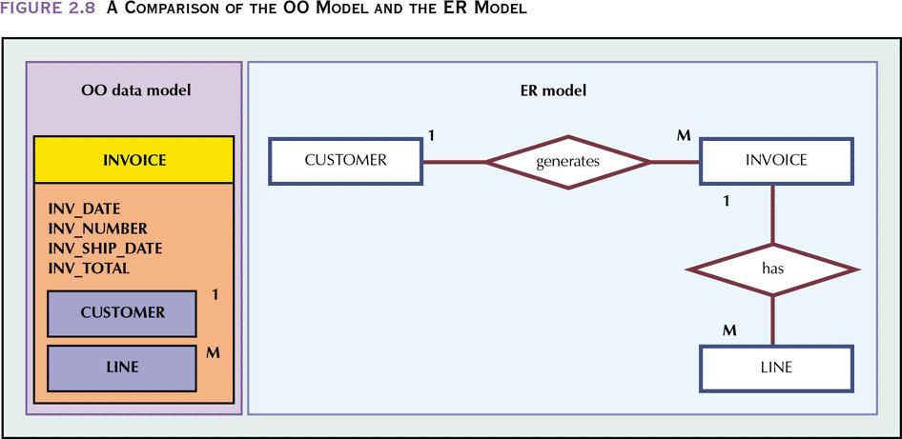
A Comparison of the OO Model and the ER Model

Slide 25
The Object Oriented Model
Advantages
Adds semantic content
Visual presentation includes semantic content
Database integrity
Both structural and data independence

Slide 26
The Object Oriented Model (continued)
Disadvantages
Slow pace of OODM standards development
Complex navigational data access
Steep learning curve
High system overhead slows transactions
Lack of market penetration

Slide 27
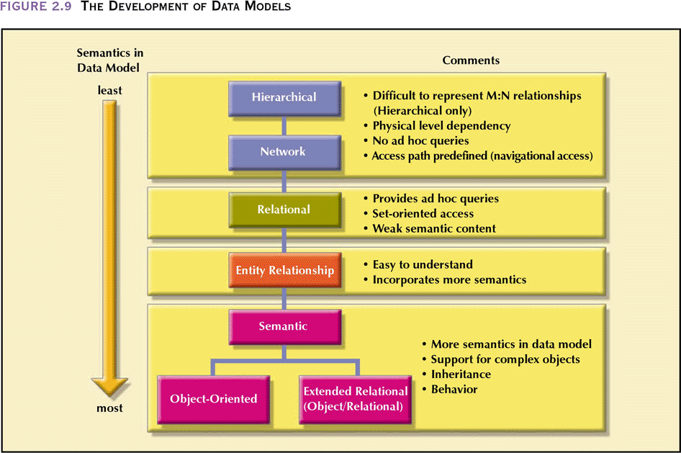
The Development of Data Models

Slide 28
Schema
Description of database is schema
Formed during database design(collecting requirements)
A displayed schema is called a schema diagram
Each object in the schema-such as STUDENT or COURSE a schema construct

Slide 29
Schema Diagram
STUDENT(Name, Student Number, Class, Major)
COURSE
PREREQUISITE
SECTION
GRADE-REPORT
Name | Student Number | Class | Major
CourseName | CourseNumber | Credit Hours | Department
Course Number | Prerequisite Number
Section Identifier | CourseNumber | Semester | Year | Instructor
Student Number | Section Identifier | Grade

Slide 30
Schema Diagram
The schema diagram represents only some aspects of a schema, such as names of record types, data-items and some types of constraints
It does not show the data type of data items, nor relationships among various files
Cannot represent a constraint like
“students majoring in computer science must take CS1310 before the end of their sophomore year”

Slide 31
Instances
The data inside the database at a given moment is called database state or snapshot
It is also called set of occurrences or instances in the database
Every time a record is deleted or inserted or a data-item value is changed, the state of the database changes

Slide 32
Database State
Empty state – on creation of a new database, with no data
On populating or loading first with initial data we get the initial state
At any point in time the database has a current state
Valid state-state that satisfies the structure and constraints specified in the schema. Ensured that every state is a valid state by DBMS

Slide 33
Schema
Schema constructs and constraints is called meta-data and stored in catalog
The schema is called the intension and a database state an extension of the schema
Changes in the schema, such as including Date-of-birth in STUDENT schema is known as schema evolution

Slide 34
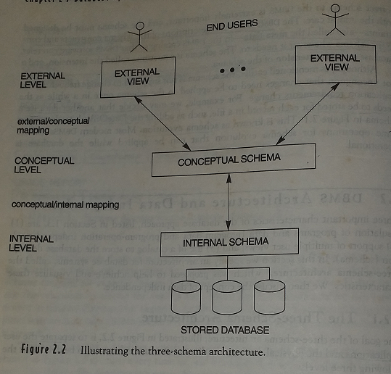
Three-Schema Architecture

Slide 35
Three-Schema Architecture
The internal level has an internal schema, which describes the physical storage structure of the database
Internal schema uses a physical data model and describes the complete details of data storage and access paths for the database

Slide 36
Three-Schema Architecture
The conceptual level has a conceptual schema which describes the structure of the whole database for a community of users
The conceptual schema hides the details of physical storage and describes entities, data types, relationships, operations and constraints
A high level data model or an implementation data model can be used at this level

Slide 37
Three-Schema Architecture
The external or view level has a set of external schemas or user views
External schema describes the portion of database that a certain user group is interested in and hides the rest of the database from that user group
A high level or implementation data model can be used at this level

Slide 38
Three Schema Architecture
Most DBMSs do not have demarcation among the three schema
The requests made at the external level is converted into requests at conceptual level and finally to the physical level
The process of transforming requests and results between levels are called mappings.

Slide 39
Data Independence
Data Independence
Capacity to change the schema at one level of a database system without having to change the schema at the next higher level.

Slide 40
Data Independence
Logical data Independence
Changes in the conceptual level does not affect changes in the external level or view.
Addition of data item or record type,
Deletion of record type
Changes to constraints
are examples of changes in the conceptual level
Application programs written for external level should work just the same

Slide 41
Data Independence
Physical data independence
Capacity to change internal schema without having to change the conceptual schema
Changes could be
Reorganization of physical files
Does not affect queries for conceptual level

Slide 42
Data Independence
Data independence achieved due to changes in mapping and not in the schema
Mapping between external view and conceptual schema
Mapping between conceptual schema and internal schema

